Slide 1
Lecture 5
16th Nov 2022
News sharing and discussion
Dr. MRIDULA MISHRA

Slide 2

News

Slide 3
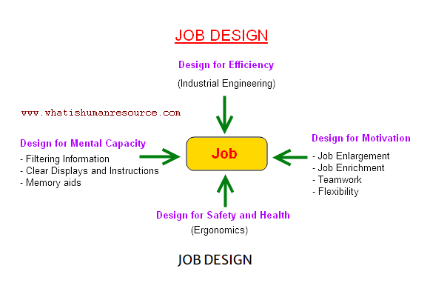

Slide 4
Unit 3
Orientation, Induction and Placement : process of orientation, induction and placement programme
Training and Development : employee training, methods of training, methods of management development
Career Planning and Management : career management, process of career planning, challenges in career planning

Slide 5
Learning outcomes
Students will be able to understand
the meaning and process of an Induction, Orientation, Socialization and Placement
enumerate the steps for an effective Induction, Orientation, Socialization and Placement programme
evaluation of orientation programme systems considerations in design of an HRIS

Slide 6
MCQs
A job design is
The design involving maximum acceptable job design qualities to perform a job
The division of total task to be performed into manageable and efficient units
A systematic way of designing and determination of the worth of a job
None of the above
Notes:
Ans: b

Slide 7
MCQs
Finding ways to reduce ________ is a key responsibility of management.
Dissatisfaction
Satisfaction
Uncertainty
Certainty
Notes:
Ans: c

Slide 8
https://www.youtube.com/watch?v=isR8rXPzPVg -Induction, Orientation and Socialisation
https://www.youtube.com/watch?v=sIIteZbRT4I - Checklist for New Employee Induction Program
https://www.youtube.com/watch?v=0vAq-_R-EiI - How NOT to Orient a New Employee
https://www.youtube.com/watch?v=khxJdKHT_qI&ebc=ANyPxKrlN6mofGAyjw0ITT0_iKwIACE7XZyAo3MoDlj5AnaxqsS3H1JE3TscLBWUHJG- Infosys Video fresher

Slide 9
Employee Orientation
Employee orientation is the systematic process of offering essential information to new employees to make them feel comfortable in the organization and also in the job.

Slide 10
Purpose of Employee Orientation
Formal welcome to employees
Overcoming initial uneasiness and hesitation
Information exchange
Assessing employees
Acclimatizing employees
Developing team spirit
Socialization

Slide 11
Types of Orientation
General idea Orientation - In this type, some general information about the organization is provided to the employees.
Job-Specific Orientation - The purpose of this orientation is to inform the employees about the various aspects of the job and other things related to it.

Slide 12
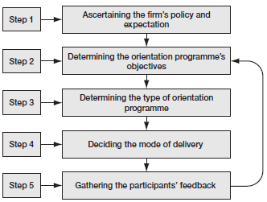
Process of Orientation Programme Development

Slide 13
An Effective Orientation Programme
Framing clear-cut objectives
Determining clearly the roles of departments and personnel
Assessing the new employees’ information requirements accurately
Selecting appropriate methodology, techniques and programme content
Creating a positive environment for new employees
Continuous review and effective feedback

Slide 14
Problems in Orientation
Data overload
Problems of boredom and rigidity
Lack of adequate time and training for facilitators
Risk of failure and counter-effects
Lack of diversity in orientation programmes
Absence of evaluation and follow-up

Slide 15
Induction
Induction is the process of introducing a new employee to his/her job and organization and giving him all the necessary information required by him/her to start his work.

Slide 16
Objective of the induction
Induction is to make the new employee feel at home and develop a sense of pride in the organization and commitment to the job.
To help the new employee to develop a close and cordial relation with the existing employees.

Slide 17
Induction process
Planning an induction process for new employees is designed to ensure that the new employees settle into their employment easily to enable them to become effective as soon as possible. According to research, effective induction processes encourage closer identification with the employers and also assists to reduce employee turnover.

Slide 18
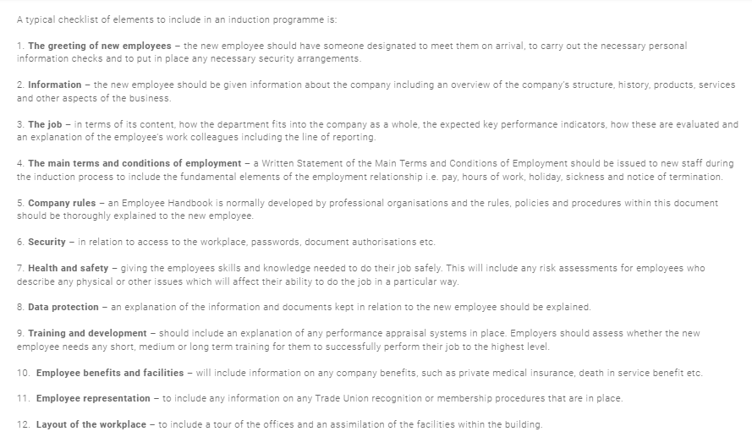

Slide 19
Placement
Placement is the process of finding an appropriate fit between the people and the positions in an organization.

Slide 20
Placement Process
Ascertaining the organization’s policy and expectations relating to the orientation programme
Determining the objectives of the orientation programme
Determining the type of orientation programme
Deciding the mode of delivery
Participants’ feedback

Slide 21


Slide 22
MCQs
Which type of information is conveyed by orientation?
a. Training and education benefit
b. Job location
c. Job safety requirements
d. General information about the daily work routine
Notes:
Ans: d

Slide 23
MCQs
___________ is a systematic and planned introduction of employees to their jobs, their co-workers and the organisation.
a. Job evaluation
b. Investiture orientation
c. Orientation
d. Placement
Notes:
Ans: c

Slide 24
MCQs
Which of these is a stage while conducting formal orientation?
Employee is given only menial tasks that discourage job interest and company loyalty
Employee is overloaded with forms to complete
Specific orientation to the department and the job, typically given by the employee's supervisor
Employee's mistakes can damage the company
Notes:
Ans: c

Slide 25
Lecture 6
23th Nov 2022
News sharing and discussion
Dr. MRIDULA MISHRA

Slide 26
Unit 3
Orientation, Induction and Placement : process of orientation, induction and placement programme
Training and Development : employee training, methods of training, methods of management development
Career Planning and Management : career management, process of career planning, challenges in career planning

Slide 27
Learning outcomes
Students will be able to understand and learn
Training and Development :
employee training
methods of training
methods of management development

Slide 28
Training
Training is the process by which an employee acquires the necessary knowledge and skills to perform the job.
Notes:
https://www.youtube.com/watch?v=85RVEas4AXs&list=PL_RJtsLejSGZGh9CQr45D5qySoKDzZfb1 - Training & Development

Slide 29
Significance of employee training
Enlargement of skills and competency
Effective utilization of the existing human resources
Enhancement of customer satisfaction
Enhancing competitive advantage
Enrichment of team spirit
Ensuring personal growth
Enabling a learning culture
Establishing a positive organizational climate
Enduring organizational growth and development

Slide 30
Training Need Assessment: Sources
Performance Evaluation
Advisory Panel
Training
Need
Assessment
Job Analysis
Ability Test Score
Attitude Survey
Feedback

Slide 31
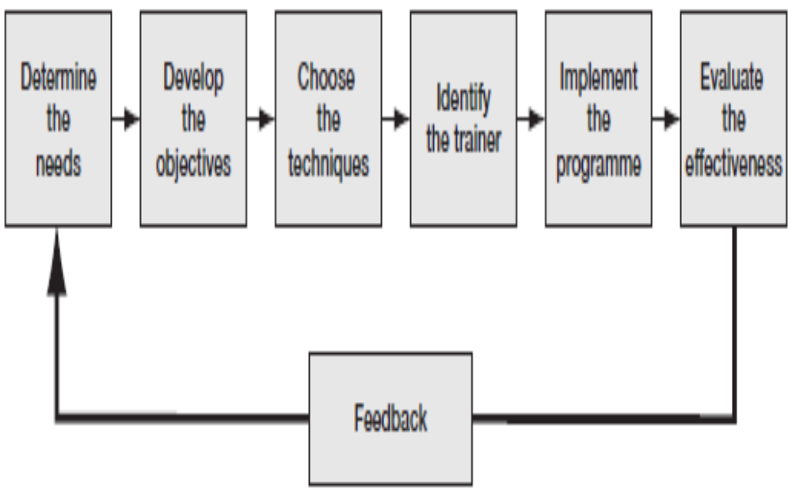
Steps in the Training Process
Organizational Analysis
Operational Analysis
Individual Analysis

Slide 32
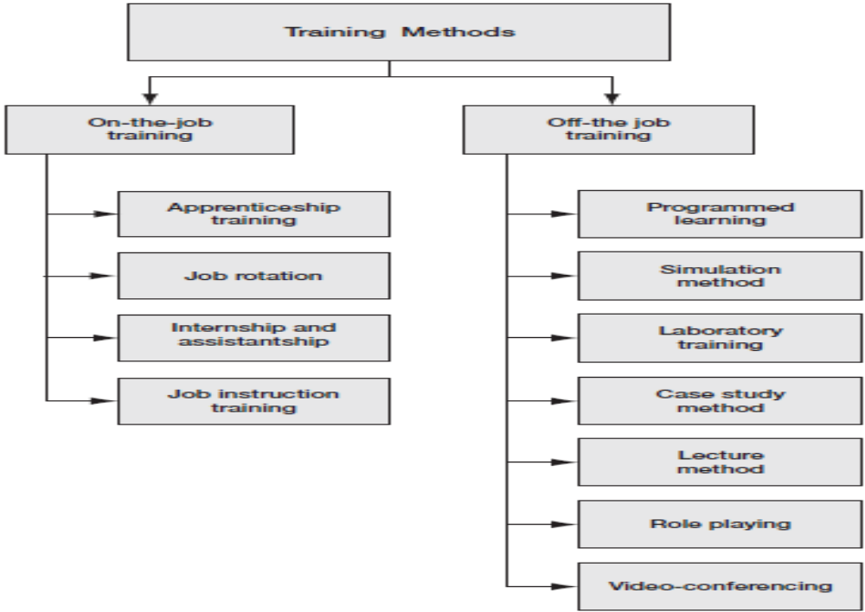
Methods of Training

Slide 33
Issues in training at micro level
The absence of corporate commitment.
The risk of poaching.
The unaffordable cost of training.
The treatment of training as expenses by the accounting rules.
Lack of adequate support from the government.
The absence of candidates with adequate skills.
Lack of cooperation between university and industry in research programmes

Slide 34
Necessary for an effective training programme
Top-management support
A receptive mindset of trainees
A continuous process
Technological advances
The form and timing of training

Slide 35
Necessary for an effective training programme
Top-management support
A receptive mindset of trainees
A continuous process
Technological advances
The form and timing of training

Slide 36
Difference in Training and Development
Training is a job oriented process. Development is a career oriented process.
Trainings are performed in an aim of improving knowledge and skill that are needed to perform their existing jobs. Developments are performed in an aim of improving knowledge and skill to face future challenges.

Slide 37
MCQs
Demonstration type of training method is used to train
Workers
Supervision
Managers
All of the above
Notes:
Ans: A

Slide 38
MCQs
Training within the industry (TWI) scheme imparts training in
Job instructions
Job rotation
Job method
All of the above
Notes:
Ans: D

Slide 39
Lecture 7
24th Nov 2022
News sharing and discussion
Dr. MRIDULA MISHRA

Slide 40
HR News links
hr.alltop.com
www.shrm.org
www.hrmasia.com
world.einnews.com

Slide 41
Unit 3
Orientation, Induction and Placement : process of orientation, induction and placement programme
Training and Development : employee training, methods of training, methods of management development
Career Planning and Management : career management, process of career planning, challenges in career planning

Slide 42
Learning outcomes
Students will be able to understand and learn
Career Planning and Management :
career management
process of career planning
challenges in career planning
management development
methods of management development

Slide 43
Management Development
Management development is a long-term process by which the managers’ conceptual knowledge and competencies are developed to make them more suitable for present and future responsibilities.

Slide 44
Significance of Management Development
To help the managers understand and share the corporate philosophy, mission and values of the business
To ensure that the managers are aware of the latest and best managerial practices
To facilitate better leadership behaviour by improving the managers’ leadership styles
To help the managers in prioritizing and optimizing the resources of the firm
To assist the managers to build on their strengths and work on their weaknesses
To help the managers to cope with the rapidly changing environment

Slide 45

Management Development Process

Slide 46
Methods of Management Development
Mentoring
Business Games
Coaching
Behaviour Modelling
In-basket training - Effective Prioritizing
Action learning
University based programmes
Executive coaches
In-house development centers
Executive orientation

Slide 47
Mentoring
Mentoring refers to teaching by an intelligent and trusted guide and advisor.
It is a one-to-one teaching-learning process.
Mentors may or may not be from the same organization but should be experienced, competent and mature.

Slide 48
Business Games
This method makes use of business games to create an interesting environment for trainees to learn their business lessons.
The primary goal of business games is to ensure the involvement of the trainees in the learning process.

Slide 49
Coaching
In the coaching method, senior managers are made responsible for coaching and developing the trainees who work directly under them.
The trainees would learn immensely from the experience and expertise of the coach.

Slide 50
Behaviour Modelling
In this method, the managers learn by imitating the behaviour (called model) of others.
The behaviour model lets the trainees learn the right way of approaching and behaving in different situations.

Slide 51
In-basket training
In-basket training is a development technique which educates the trainees about the need for and techniques of prioritizing the situations that await their responses.
It helps managers in prioritizing the numerous business papers, reports, e-mails and telephone messages before acting on them.

Slide 52

Effective Prioritizing
URGENT &
IMPORTANT
I
IMPORTANT &
NOT URGENT
NOT URGENT &
NOT IMPORTANT
IV
II

Slide 53
Action learning
It is a development technique that allows trainee managers to work on the problems of some other departments and not on those of their own department.
On a full-time basis, a group of trainees analyse the real-world problems of a department and make recommendations.

Slide 54
University-based Programmes
In this method, managers seek to develop knowledge by joining the programmes offered by universities, colleges and centres of excellence like the IIMs and the IITs.

Slide 55
Executive Coaches
It is a programme of one-to-one collaboration between a certified external coach and a manager.
Through executive coaching, the manager improves his or her leadership skills, gains new perspectives and reaches maximum potential.

Slide 56
In-house Development Centres
Large companies are establishing their own in-house development centres to develop the required skills and knowledge among its employees.
In-house development centres are also known as corporate universities.
In-house development centres usually make available those courses and programmes which exactly support the management development requirements of the firm.

Slide 57
Executive Orientation
Orientation is an initial training effort to inform the new managers about the company, the job and the work group.
This technique is adopted to assist the new managers in learning the firm’s structure, culture and practices quickly.

Slide 58
https://www.youtube.com/watch?v=mxbXeLhK8mk - Career Development Software for Employee Career Planning

Slide 59
Terms used in Career Planning
Career - Upward movements
Career Path - Deliberate advancement
Career System - Creation of an integrated employee development system for supporting the career aspiration
Career Management - Personal Career and Organizational Career Management
Career Counselling - Guidance given by experts
Career Anchoring - Factors that influence the selection of the individuals
Career Cluster - Categorization of different occupations
Career Success – Ability, performance performing a demanding work.

Slide 60
Career Planning
Career planning refers to the process of identifying and accomplishing the employees’ career objectives through a systematic way of skill identification, assessment and development.

Slide 61
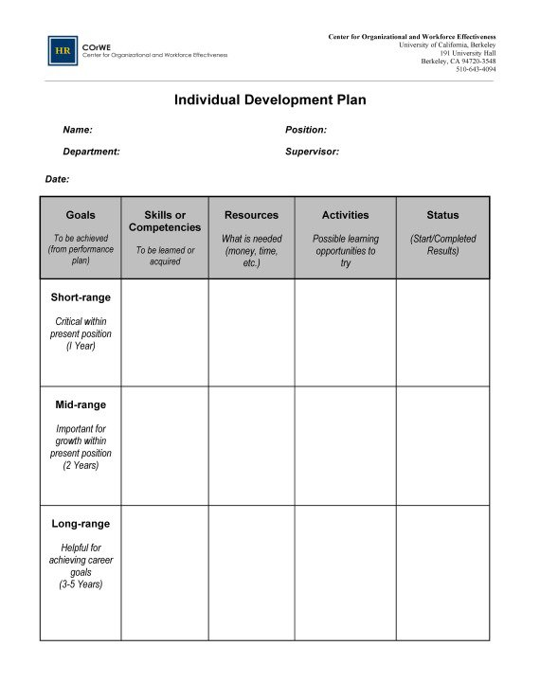

Slide 62
Features of Career Planning
Career planning normally follows a bottom-up approach.
It is an ongoing process
It aims at matching the individual’s career goals with the opportunities available.
It is the Collective responsibility of the individual employee and the firm.
It is normally made in a dynamic environment.

Slide 63
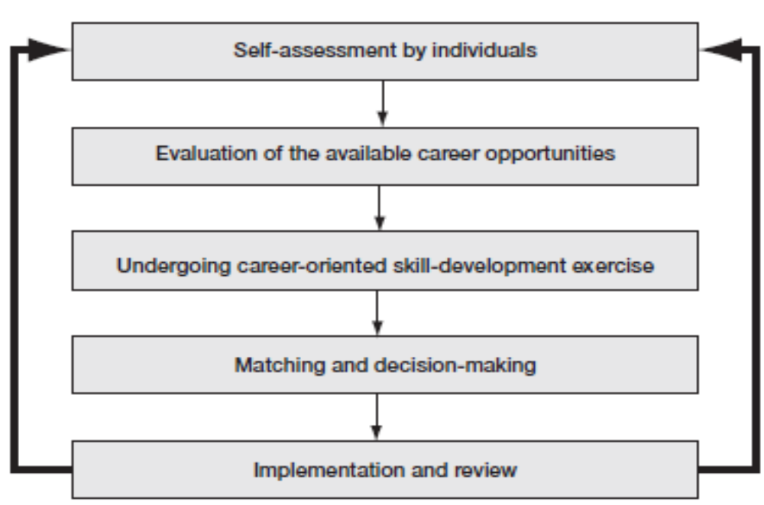
Process of Career Planning

Slide 64
Step I: Self-assessment by the individual
The individual employee must make a realistic assessment of himself or herself from the career planning perspective.
The self-assessment techniques are:
Leadership Style Affiliative, Authoritative, Coaching, Coercive, Democratic, Pace-setting
The Myers–Briggs type indicator (MBTI) assessment technique.
Fundamental Interpersonal Relations Orientation-Behavior (FIRO-B)

Slide 65
Step II: Evaluation of the Career Opportunities Available
At this stage, the employee attempts to connect himself or herself with the career opportunities existing within the organization.
Career opportunity identification is usually the collective responsibility of both the individual and the organization.
In this stage, only a provisional selection of career opportunities is made with the aim of determining the training needs of the employee.

Slide 66
Step III: Undergoing Career-Oriented Skill Development Exercises
Once the employees are aware of their competency requirements, they choose their source of learning.
The organization normally takes up the responsibility of providing the necessary learning to the employees.
The organization may use any of the methods like self-learning, on-the-job learning, distance learning, e-learning, work-based learning and action learning to train the employees.

Slide 67
Step IV: Matching and Decision-making
After the necessary training, the employees at this stage make a final comparison of the career opportunities available and their own career goals.
An employee may finally settle for a strategy that suits his or her career aspirations best.

Slide 68
Step V: Implementation and Review
At this stage, the employees adopt a step-by-step procedure to successfully attain their career goals.
Organizations usually develop career paths for employees and move them on those predetermined career paths through promotions, transfers, etc.

Slide 69
Types of Career Paths
Conventional Career Path
Dual Skill Path
Lateral Career Path
Network Career Path

Slide 70
Types of Career Paths
Conventional Career Path - In a conventional career path, employees move up from one job to another located immediately above their present job in the organizational hierarchy.
Dual Skill Path- This refers to a situation in which the employee enjoys an option to decide between two career paths available in the firm.
Lateral Career Path - This is a horizontal movement in the career path of an employee.
Network Career Path - This is a combination of lateral and vertical movements.

Slide 71
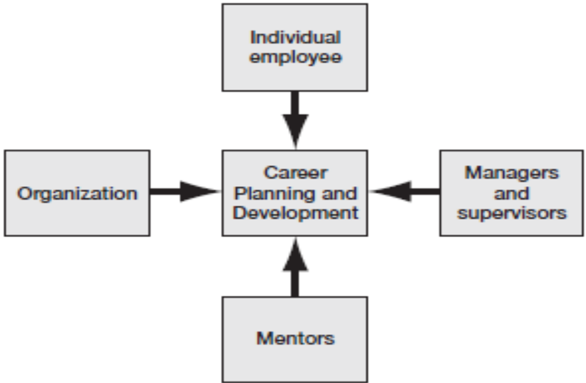
Responsibility for Career Planning and Development

Slide 72
Merits of Career Planning
It helps the employees in developing career goals.
It enables the employees to identify the career opportunities available.
It helps the employees determine their training and development requirements.
It helps the organization in finding a fit between the job requirements and the employee’s knowledge.
It provides an occasion for the organization to identify the strengths and weaknesses of its workforce.

Slide 73
Merits of Career Planning (contd.)
It assists the organization in HR policy formulation.
It helps the organization in achieving enhanced job satisfaction and efficiency.
It aids the organization in controlling employee attrition and related hiring costs.
It enables the organization to achieve cordial industrial relations.
It helps the organization in building goodwill in the labour market.

Slide 74
Limitations of Career Planning
Time-consuming
Unsuitable for a large workforce
Lack of objectivity
External interventions
Lack of knowledge and awareness
Mechanical process
Difficulty in measuring career success

Slide 75
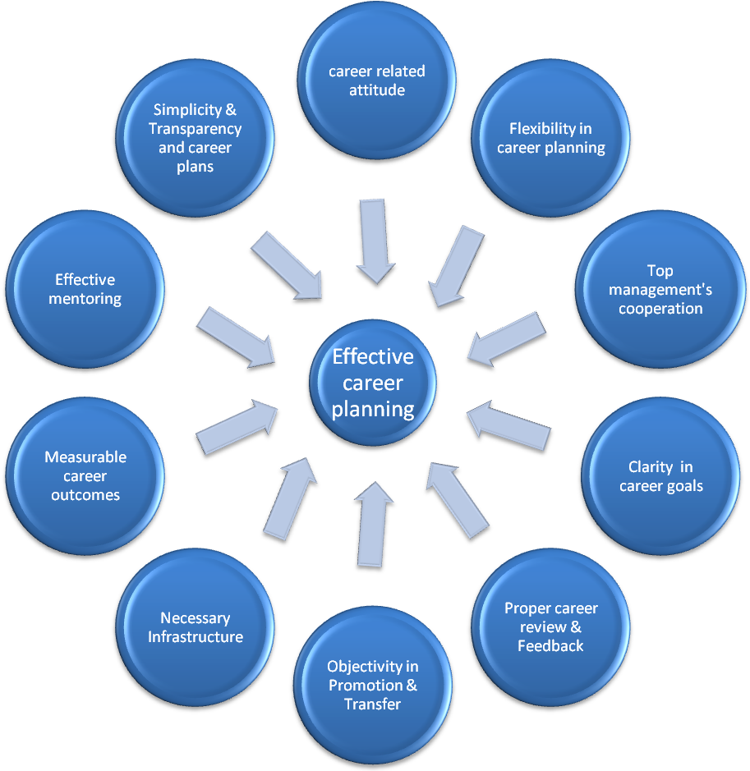
Measures to improve the Effectiveness of Career Planning

Slide 76
Measures to improve the effectiveness of career planning (contd.)
Developing career-related attitude
Achieving flexibility in career planning
Ensuring cooperation of the top management
Clarity in career goals
Proper career review and feedback
Objectivity in promotions and transfers
Establishing necessary infrastructure
Developing measurable career outcomes and success
Effective mentoring as part of career planning
Simplicity and transparency in career planning programme

Slide 77
Career Guidance
Career guidance refers to a series of processes aimed at assisting the employees to make informed career decisions and achieving career and personal development.

Slide 78
MCQs
Career planning is
Leaving the decisions to seniors and parents
Getting information and not taking timely decision
Going along with peers and other personal relations
Exploring and taking decisions in congruence with one’s own self
Notes:
Ans: d

